Slide 1


Trusscore LinkedIn Playbook
/ Individual Voices vs Company Voice
LinkedIn, and the few minutes a week that actually move it
Material Science for Building Materials

Slide 2


On LinkedIn, Brands Don't Get Reach, People Do
LinkedIn stopped showing company pages to people, it shows people to people. So our reach now depends on real profiles, not the Trusscore account and logo.
Where our reach actually comes from now:
~5%
~65%
of the feed goes to company pages
goes to personal profiles, like yours
Personal profiles earn roughly 70% more reach than company pages.
Notes:
The single most important idea. The page is not the engine, people are.

Slide 3
You're Not Just Reach, You're the Channel
You've spent your careers building relationships with builders, contractors, distributors, and dealers. When you post or comment, that's not just visibility we'd otherwise pay for, it’s working the same channel relationship you engage with every day, showing up where our customers and partners can see it.
Distributors & Dealers
Architects & Specifiers
Builders & Contractors
The people who can choose what goes on the wall
The relationships you already manage, made visible
The people who write us into the project
Notes:
Make this personal and flattering, because it's true.

Slide 4
What Makes a Post Land
Sounds like you
Keep it real
Your words, your story. Identical copy from everyone gets buried by LinkedIn anyway.
Real jobs, real numbers, real people. AI-sounding filler gets penalized and people see through it.
Links go in the comments
Tag partners and customers
A link in the post itself cuts reach by about 60%. Drop it in the first comment instead.
When you tag them, they reshare, and you reach their whole network too.
Notes:
Links-in-comments is the rule people break most.

Slide 5
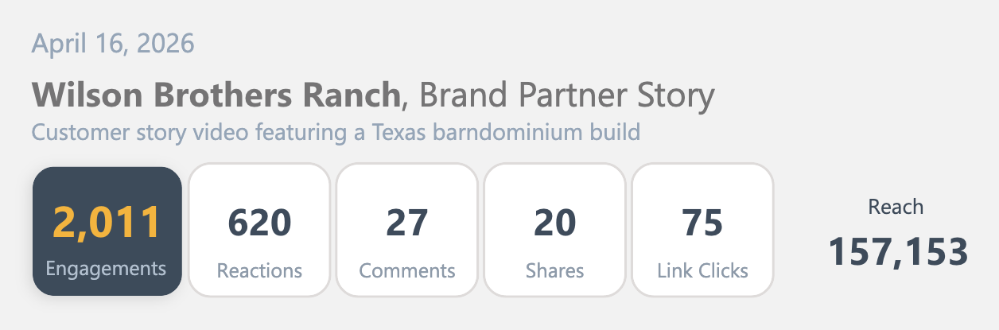
We Can Help, but You Add the Real Part
You'll never face a blank page, we can provide help with ideas and content
Notes:
Posting is never a writing assignment. Carlie's team packages everything.

Slide 6
What We're Not Asking You to Do
✕
✕
✕
Become an influencer
Spend hours on it
Be clever or salesy
No personal brand, no hustle, no daily posting.
Minutes a week. Most of it is one tap.
No witty hooks required. Real beats clever every time.
Notes:
Removes the fear of becoming a LinkedIn personality.

Slide 7
The Whole Ask: Two Things
1
2
1
Comment in the first hour
Post something real, with our help
When Dave or a teammate posts, leave a real comment within the hour. Two minutes. This is the most important thing on this slide.
Once in a while, share something from the field: a job, a question you hear, a lesson. We hand you a starting point. You make it yours.
Notes:
If they only do #1, the program still works.

Slide 8
Answer One Question, That's Your Post

Slide 9
Why the First Hour Matters
5x
More Reach
When three or more people comment in the first 60 minutes.
LinkedIn tests every post on a tiny slice of the audience first. Early comments tell it the post is worth showing to everyone else. Your comment is the lever. It costs two minutes and it's free.
Notes:
Comments, not likes. Social pings the team channel when something goes live.

Slide 10

Ways to Start, With Examples
The Job Site Observation
The Job Site Observation
Shoutout to the team at this distributor
They don't just stock the product, they teach their counter staff to sell the finished space, not the SKU
That’s the difference between moving boxes and building a category
Shoutout to the team at this distributor
They don't just stock the product, they teach their counter staff to sell the finished space, not the SKU
That’s the difference between moving boxes and building a category
Notes:
Real, field-grounded. A rep's own partner shoutout is genuine channel development, the same relationship work Darryl runs formally, not just a content template. Tagging the partner gets us reshared into their network too.

Slide 11
Getting Started This Week
Three steps. Five minutes.
1
2
3
Follow the team
Turn on post notifications
Comment on the
next post
Connect with Dave and your colleagues so you see their posts.
So you catch the first hour. Or watch for the team-channel ping.
One real sentence. That's your first win, today.
Questions, or want a draft? The social team has you. Reach out to Carlie anytime.
Notes:
End with a concrete action today: comment on the next post.

Slide 12
Two Minutes, the Right Network
That's the Whole Ask
You already built the audience. Let's go use it.

